Slide 1

Form Recommendation System by Barış Şenol
My Mentor: Ahmet Can Baş
Fraud&abuse team

Slide 2

Data and Ideas
Main goal is recommending users templates they need.
There are 2 important parameters:
Descriptions of forms
Title of forms
Description
Title

Slide 3


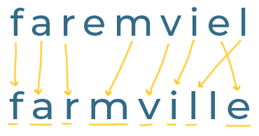
Using Keywords
Sentence
Keywords
Check Actual Titles
String Similarity

